Slide 1
Graph-Driven Regularized Regression
Christina Doka

Slide 2
Motivation
Adoption: Companies use graph theory (nodes & edges) for high-stakes tasks like fraud detection and influencer marketing.
The Problem: Calculating complex features on millions of nodes creates noise and costs millions in computing power.
Notes:
Modern enterprises increasingly rely on graph analytics to extract value from their data, using node-link structures to solve critical problems like influencer identification and fraud detection. However, calculating every possible network metric is computationally expensive and introduces statistical noise.

Slide 3
Solution
This project proves that Machine Learning Algorithms for Feature Selection (e.g. Lasso) can isolate the few metrics that actually matter.
The Result: We can ignore expensive, redundant metrics, saving time and money without losing accuracy.
Notes:
This project demonstrates that by using models capable of automatic feature selection (like Lasso), organizations can identify the 'minimum viable signal.' This proves that expensive, complex metrics are often unnecessary, allowing companies to save millions in computational costs while maintaining predictive accuracy

Slide 4
Data Processing
Dataset: I’m using the GitHub dataset (musae_git_edges.csv) with ~37k nodes and ~289k edges.

Slide 5
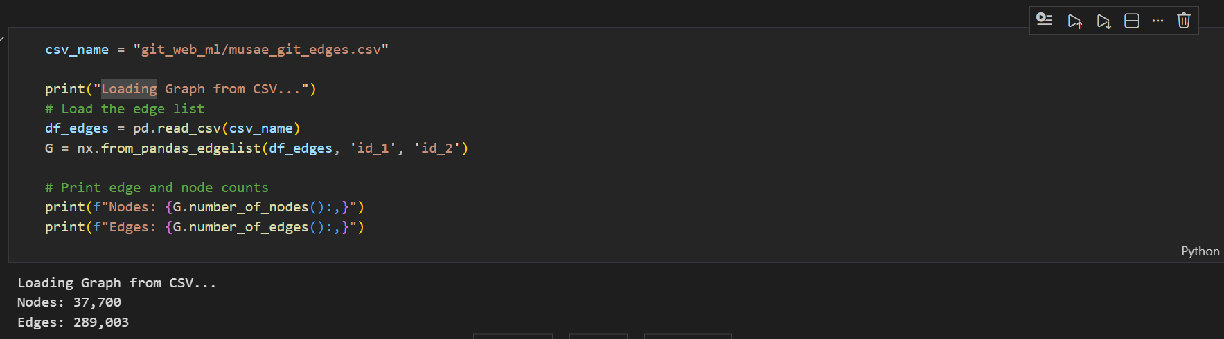

Slide 6
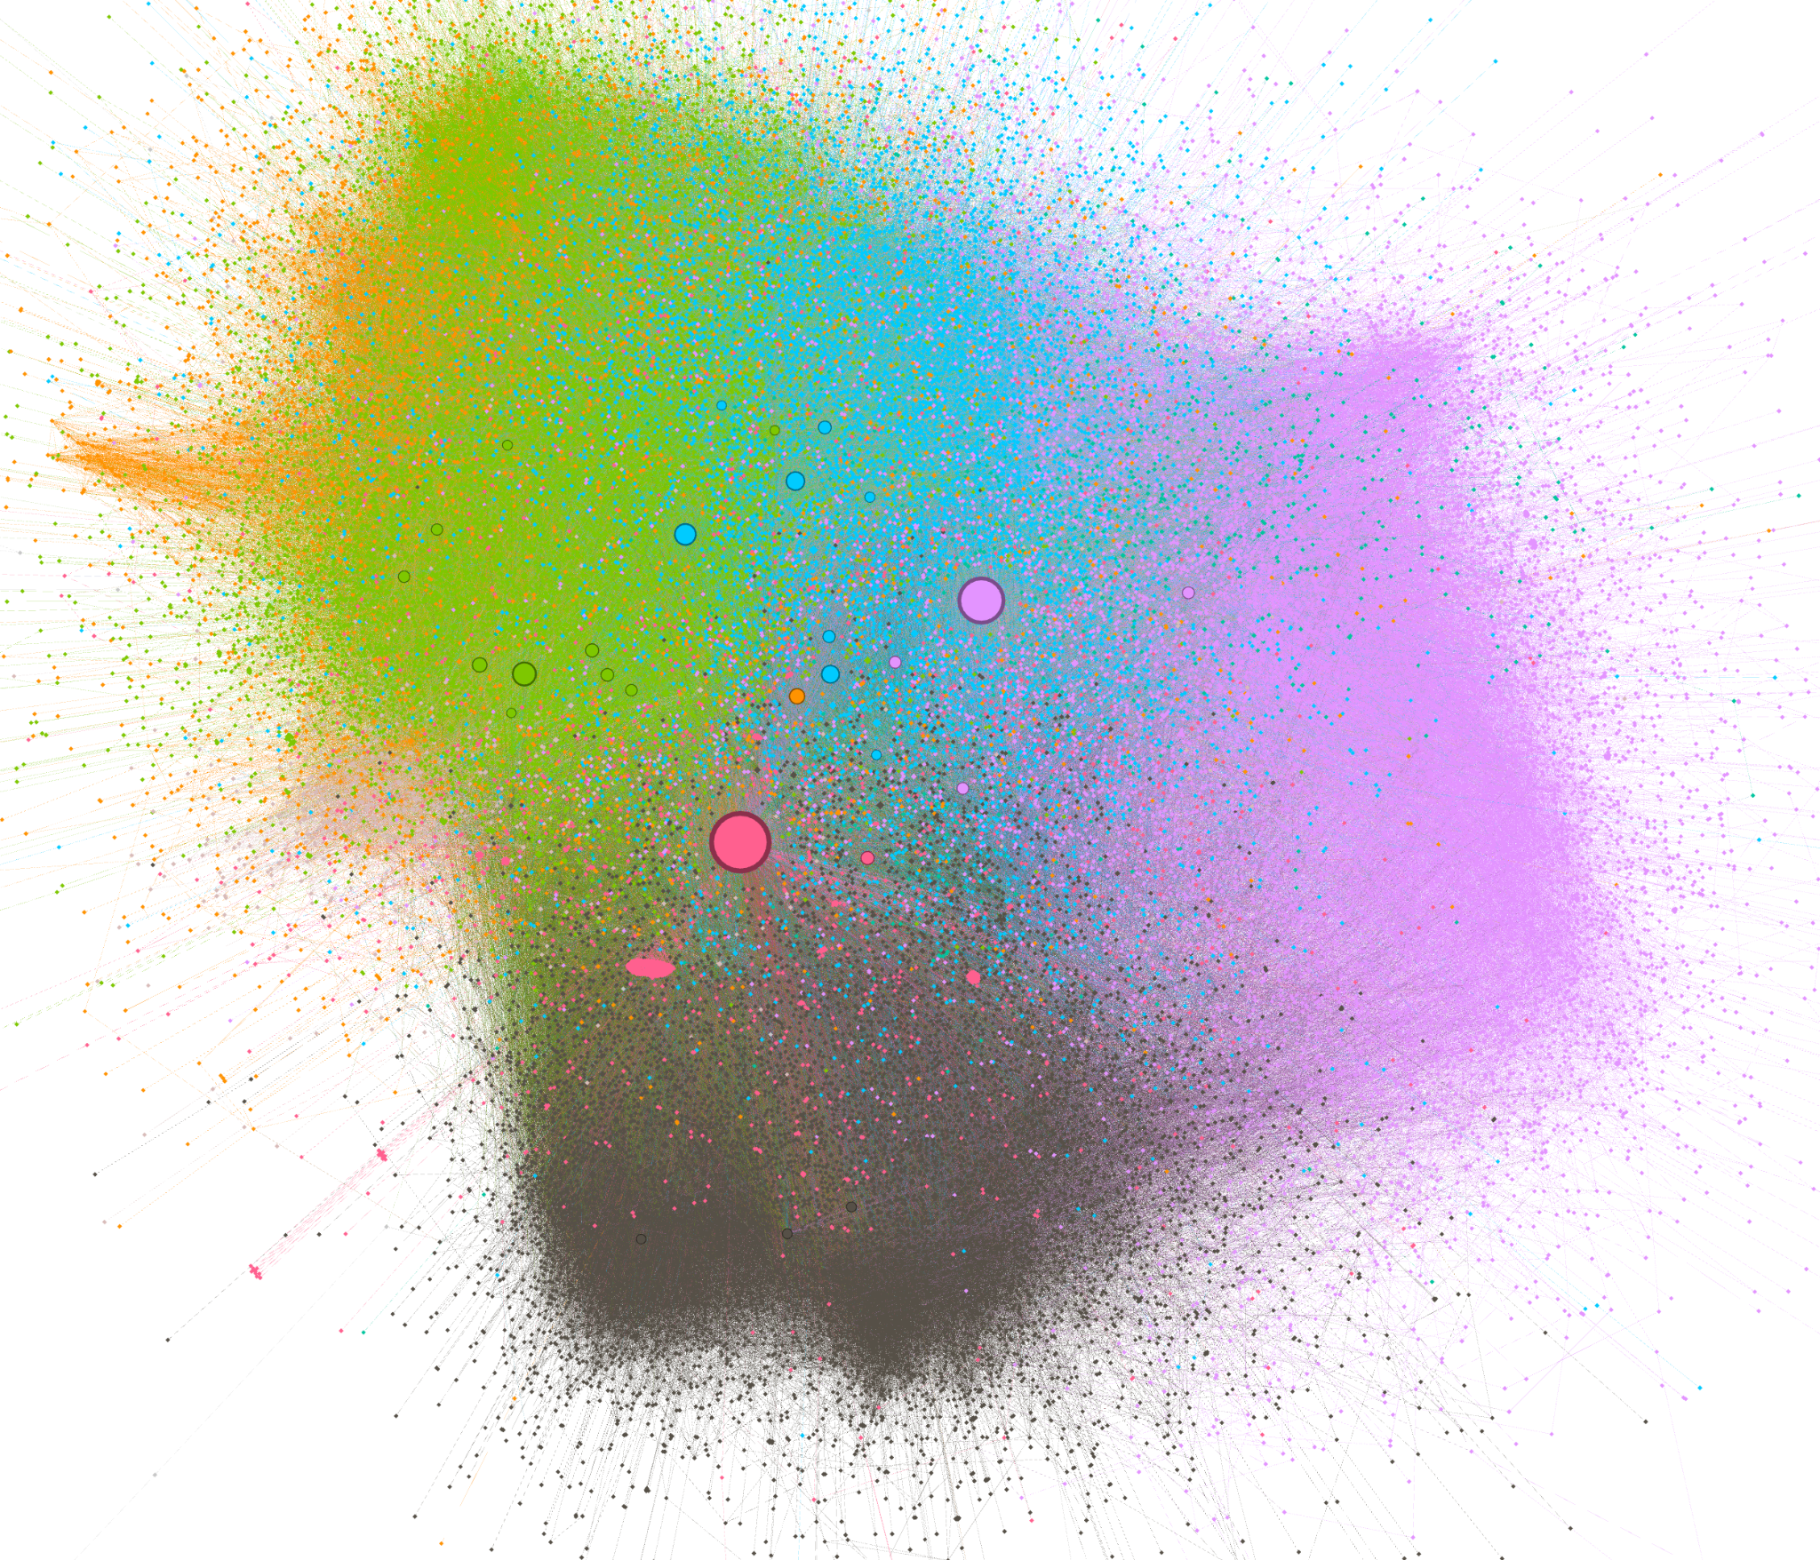

Slide 7
Features extracted
Degree PageRank Clustering Coefficient Approximate Betweenness

Slide 8
Formula weights for High Influence
Notes:
5 is a bias score for positive weights , if bias was 0 or negative the users with lower stats may end up with negative influence score higher bias the deference between a star and a nobody becomes smaller

Slide 9
Qualitative Verification of Structural Topology
Does the network have actual structure that our algorithms can exploit, and where does the model fail?
Notes:
We visualized the network topology to verify the complexity of the dataset. The distinct color clusters confirm strong community structures, validating our decision to include 'Clustering Coefficient' as a regressor. Furthermore, by mapping prediction errors to node sizes, we can visually debug exactly which influential users our model struggled to predict.

Slide 10
Machine Learning Models Used
OLS: Can become huge if features are correlated. Non feature selection
Ridge: Coefficients are shrunk towards zero but rarely reach exactly zero. Keeps all features but reduces their impact.
Lasso: Can force coefficients to be exactly zero. performs automatic feature selection by zeroing out less important variables

Slide 11
Train / Test Split
I split our graph of 37,700 nodes into two subsets using a 70-30 ratio:
Training Set: fit our models on roughly 26,000 nodes.
Test Set: held back roughly 11,000 nodes to serve as unseen data.

Slide 12
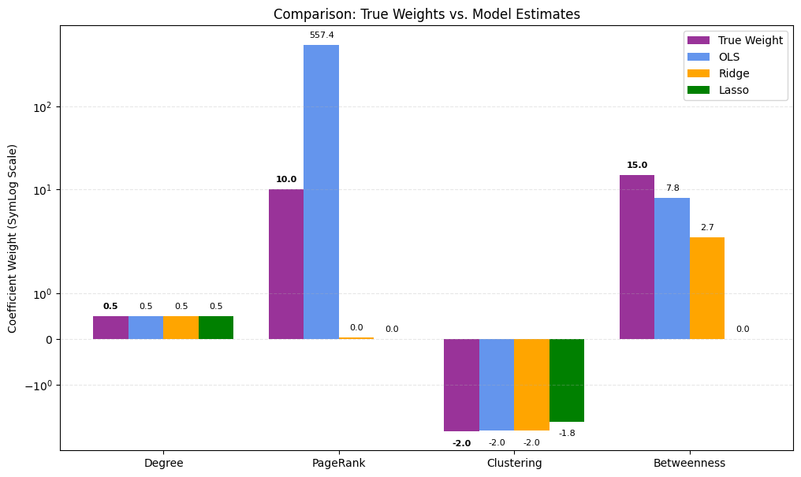

Slide 13
Regularization Path Analysis.
To understand the stability of our features, we analyzed the Regularization Path, sweeping the penalty parameter Alpha across four orders of magnitude.

Slide 14
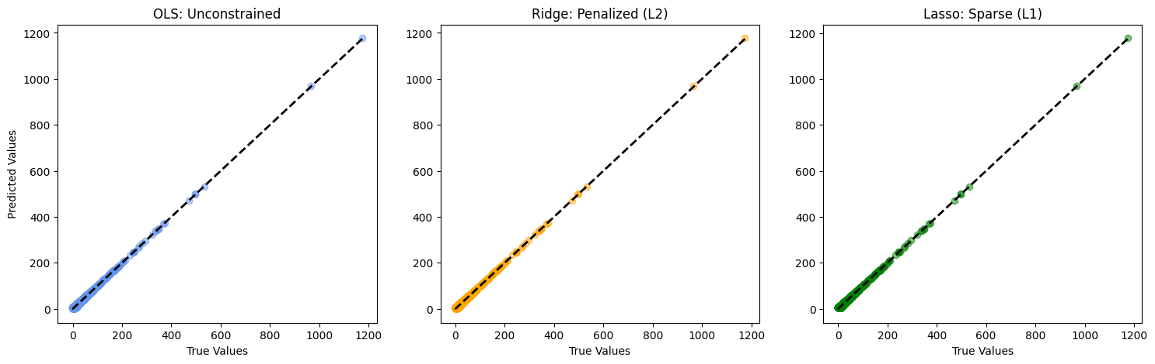

Slide 15
Evaluation of Models
Predictive Error (RMSE): Used to measure raw accuracy.
Structural Error (Coefficient Deviation): Used to measure physical reality.
Sparsity (Feature Count): Used to measure interpretability

Slide 16
